Slide 1

My Implement of AdaBoost
By Group 3

Slide 2
1. Boring Code
Algorithm
Principle

Slide 3
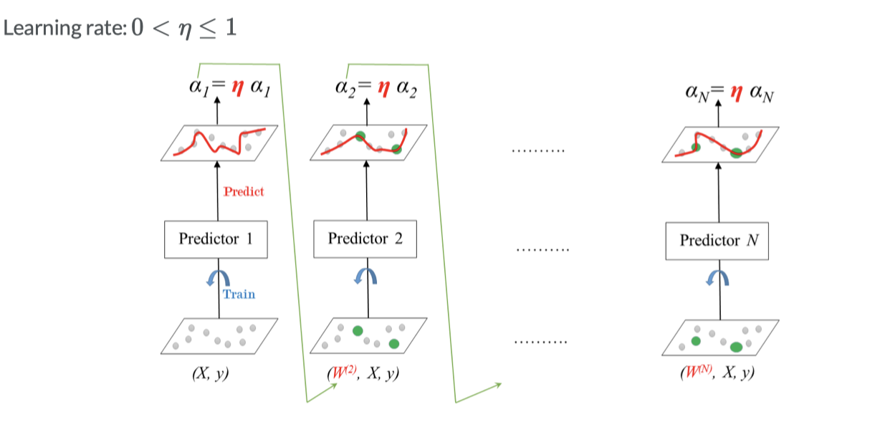

Slide 4
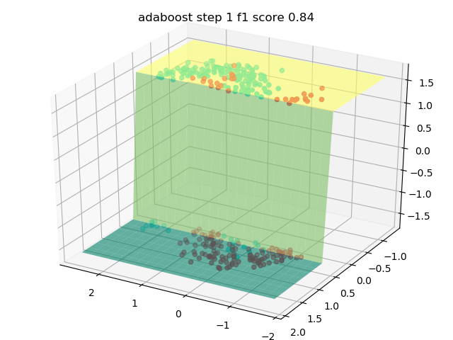
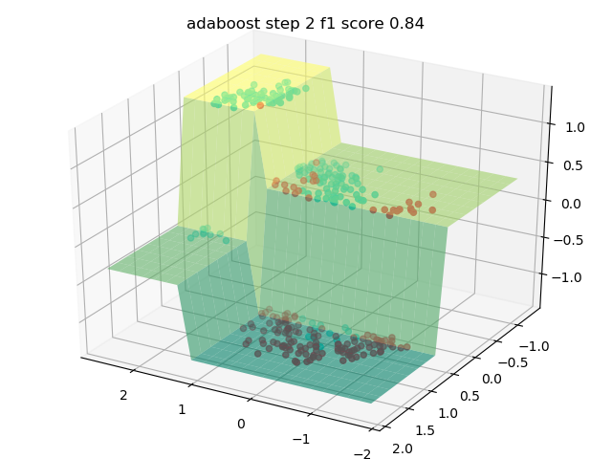

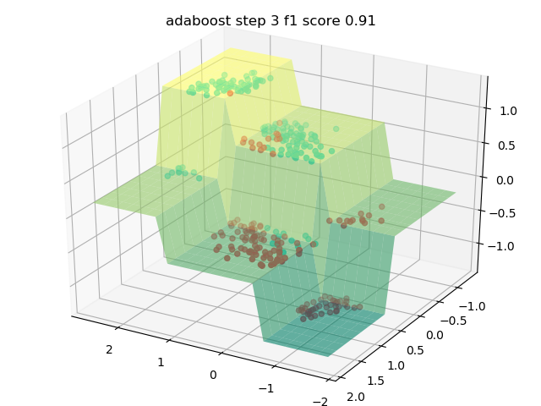
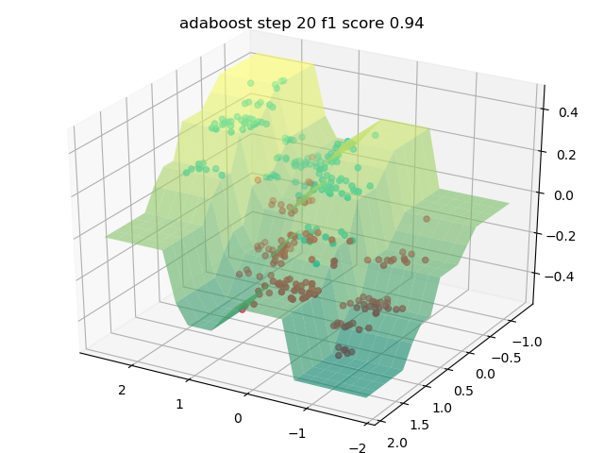
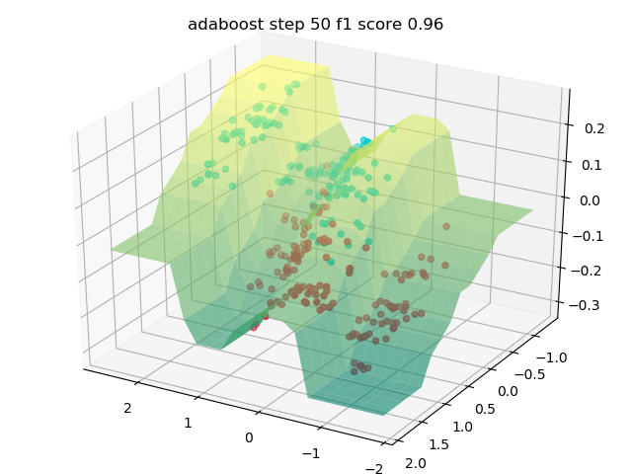


Slide 5
1. Boring Code
Code &
Dataset

Slide 6
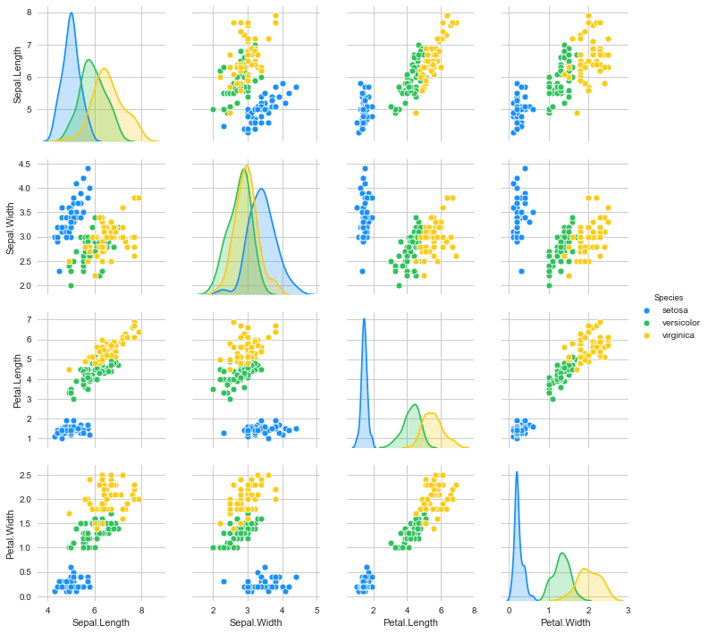
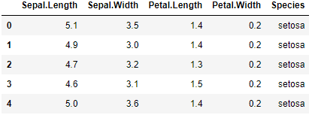
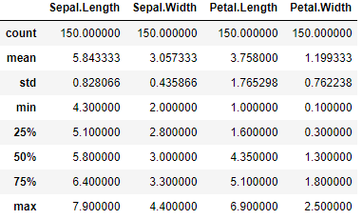
The iris dataset consists of 3 different types of irises’ (Setosa, Versicolour, and Virginica) petal and sepal length, stored in a 150x4 numpy.ndarray. The rows being the samples and the columns being: Sepal Length, Sepal Width, Petal Length and Petal Width.

Slide 7
__init__
Initialize
__next__
Start next iteration, i.e. add a new base classifier using SAMME algorithm [1]
predict
Mode: {‘mean’, ‘sign’, ‘vote’}, optional
attrsplot
plot some attributes (e.g. alpha, precision, sample_weight )
contourplot
Plot prediction surfaces (‘3d’ mode) or contour (‘2d’ mode)
DTprint
Print decision trees by graphviz
[1] J. Zhu, H. Zou, S. Rosset, T. Hastie, "Multi-class AdaBoost", 2009.

Slide 8
1. Boring Code
Results &
Comparisons

Slide 9
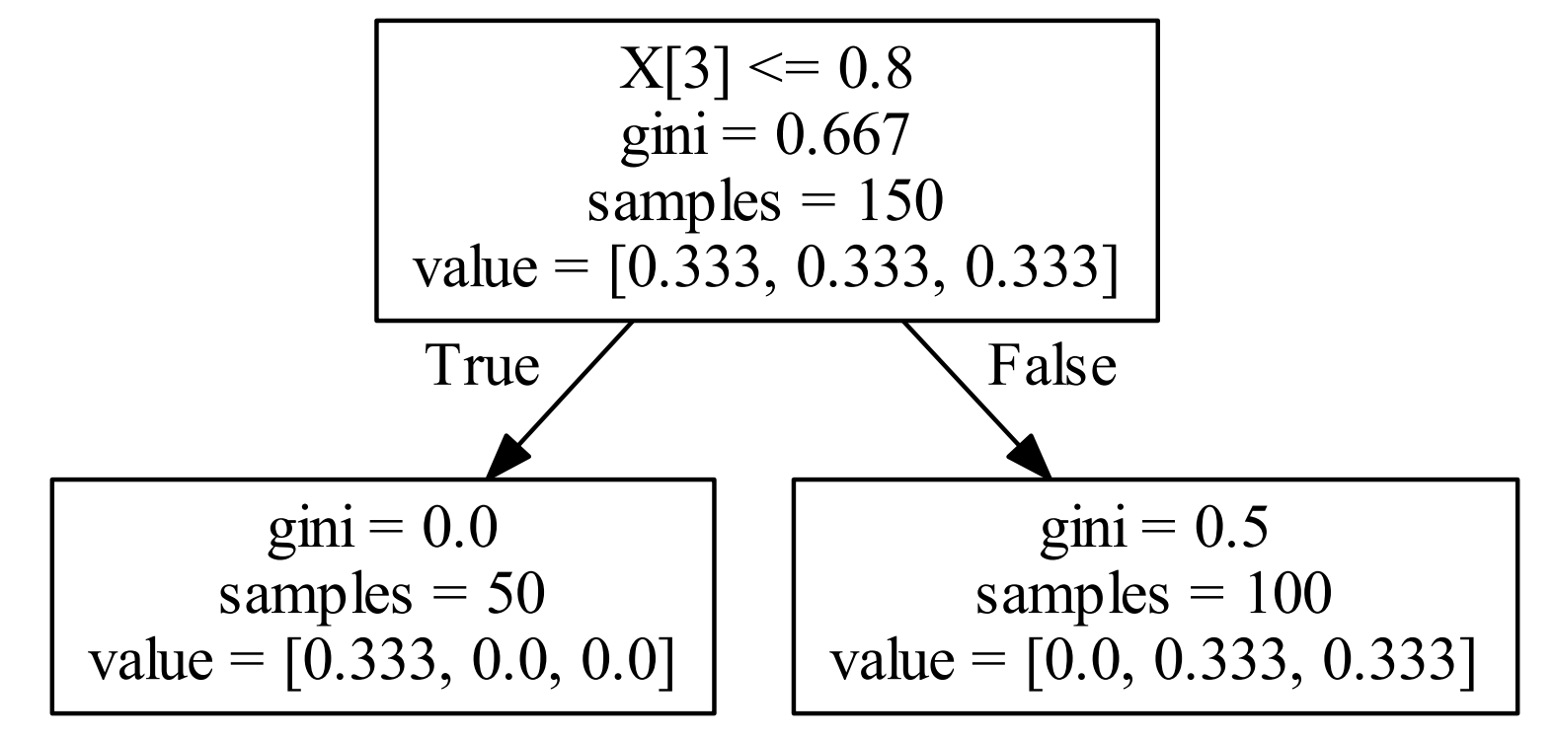
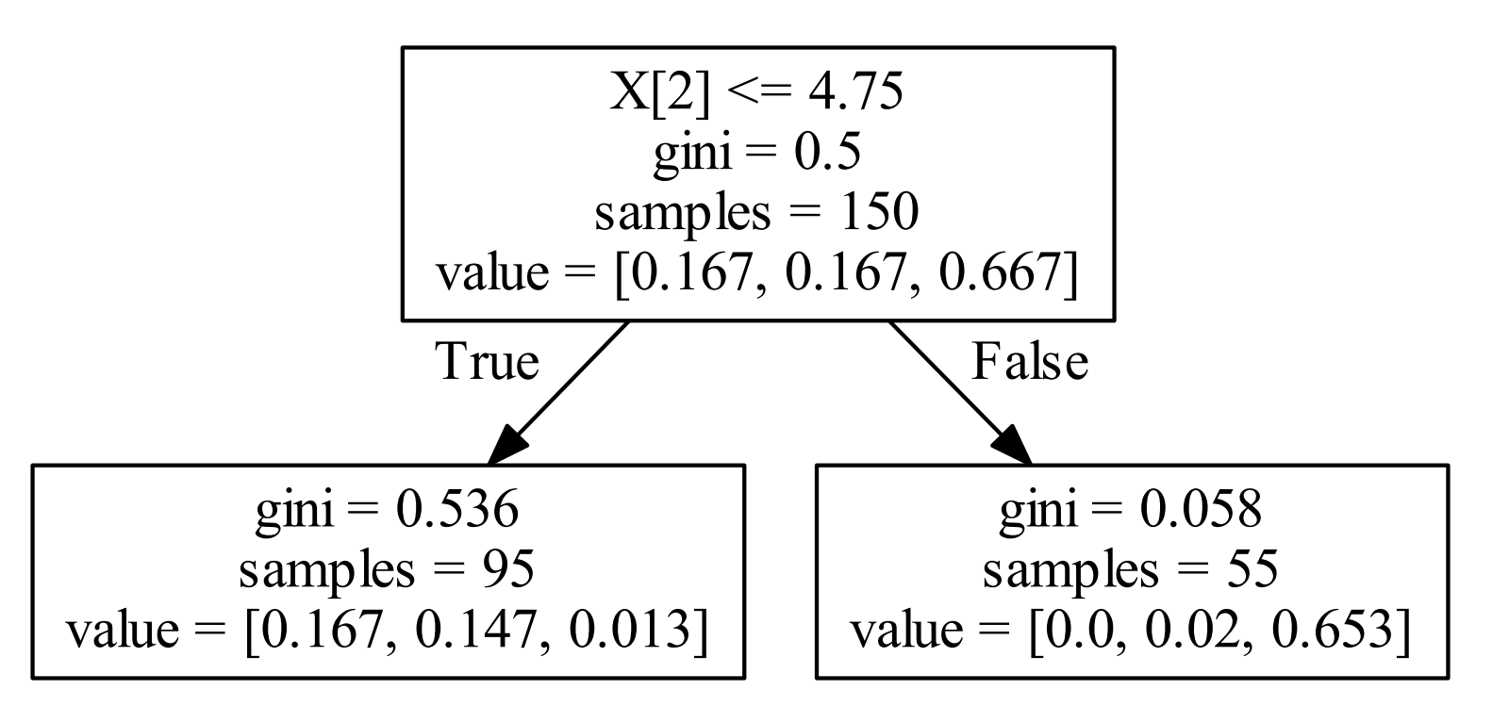
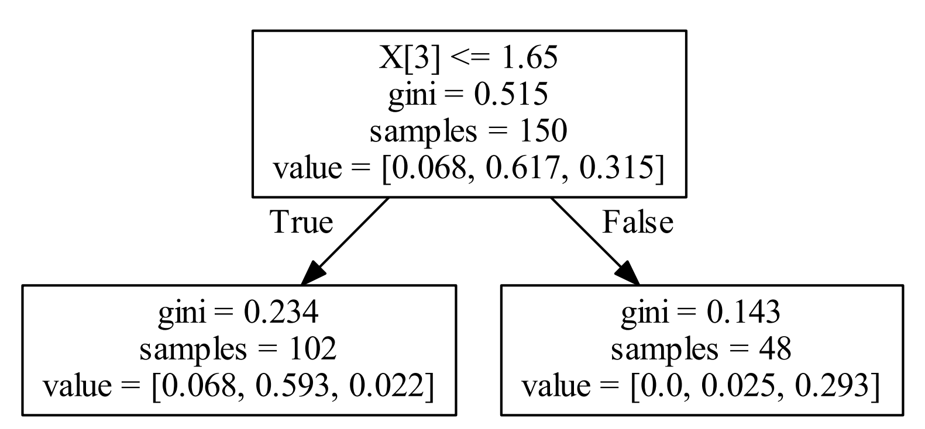
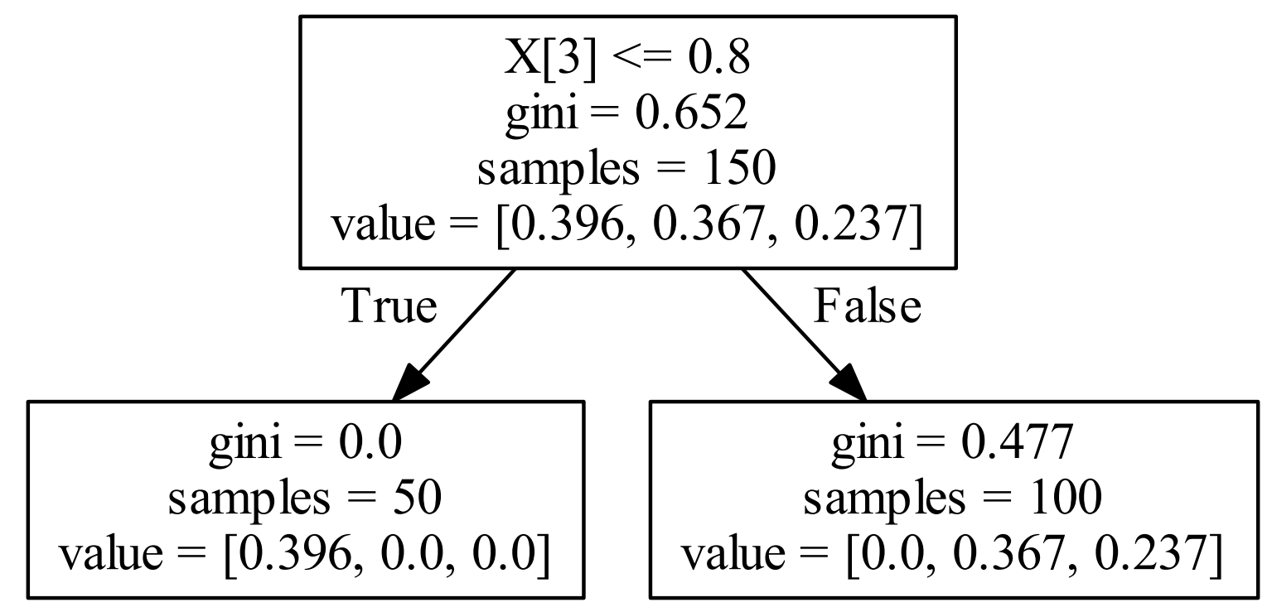
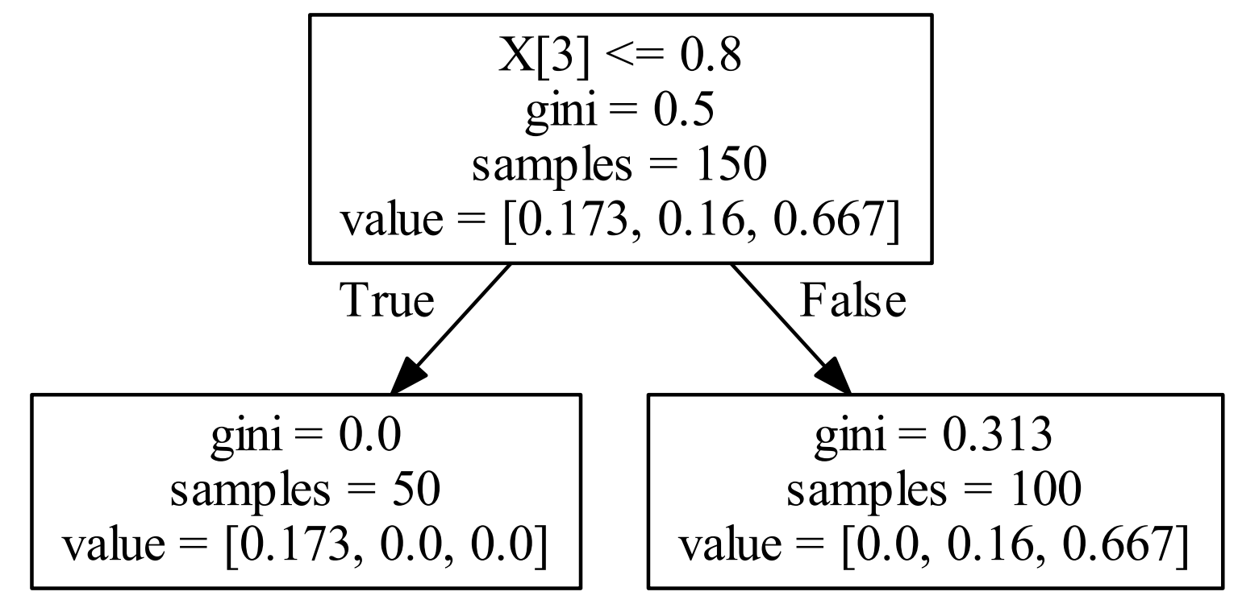
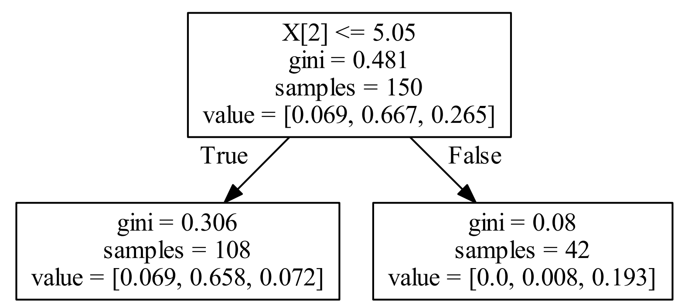
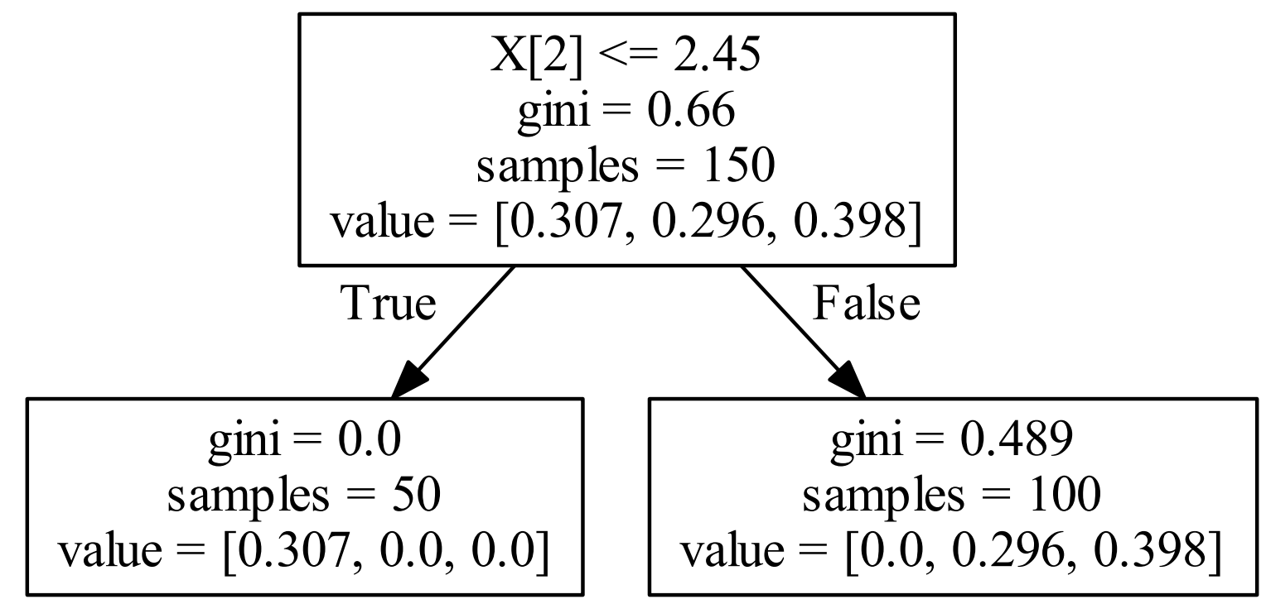
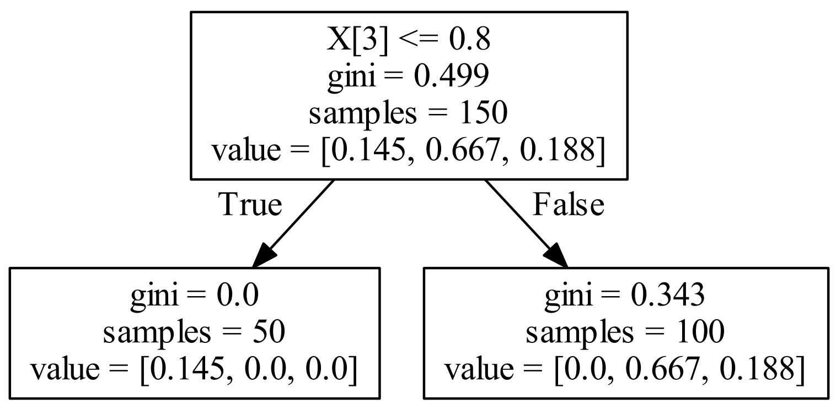

Slide 10
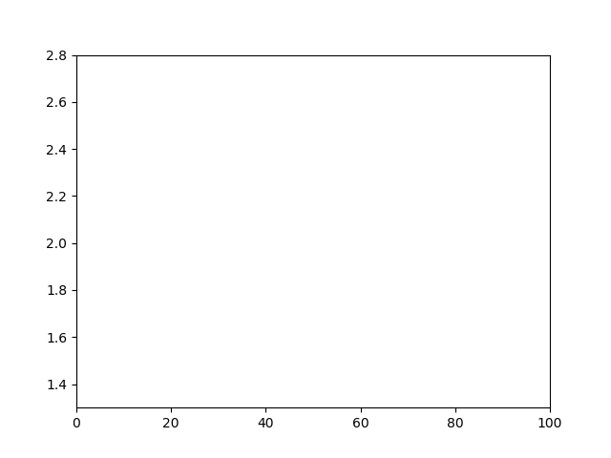
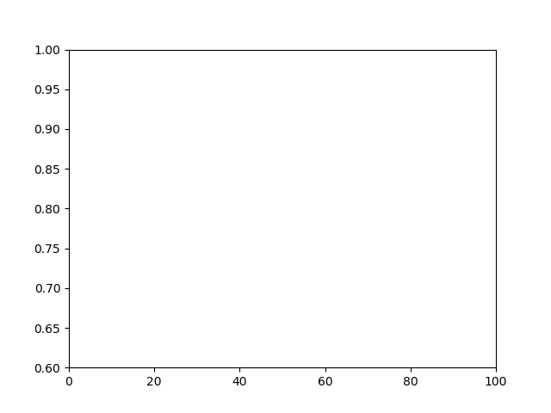
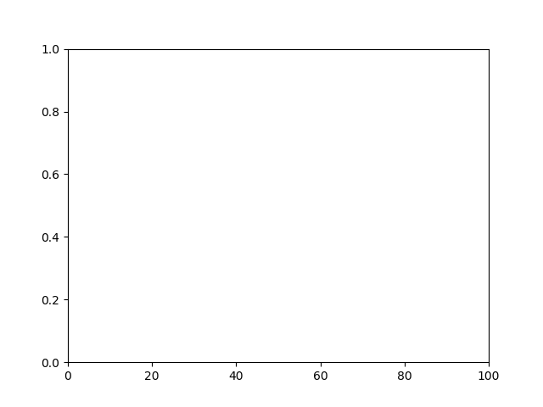
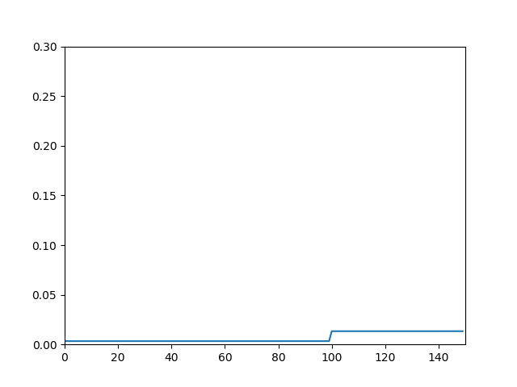

Slide 11
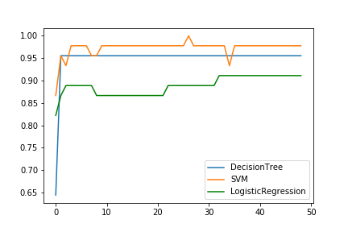
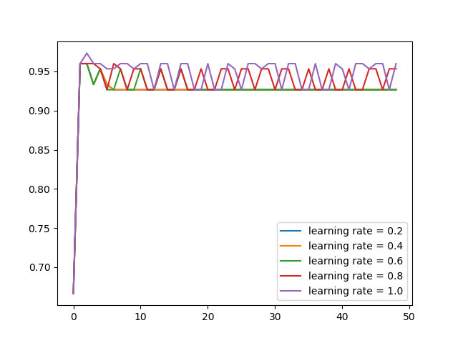

Slide 12
Thanks!

